Slide 1
CS513
Homework 1 Automatic Lens Smear Detection
Professor: Xin Chen
Group Member: Shujun Zhang A20306899,
Chen Xu A20377739

Slide 2
Outline
INTRODUCTION
AIM
ANALYSIS
STEPS
DEVELOPMENT ENVIRONMENT
APPROACH
EXAMPLE/RUN THE PROGRAM
RESULT
DISCUSSION AND CONCLUSIONS
REFERENCES

Slide 3
INTRODUCTION
Dirt and dust or smear on camera lenses is one of the important artifacts in digital imaging systems.
Cleaning the camera lens or to choose better spot to retake picture is not that easy when the cameras are installed outdoor for security, or installed underwater.
Therefore, it is necessary that we detect the blur caused due to that smear on the lens.

Slide 4
AIM
In this assignment, the idea is to create a mask which shows the smear on each camera. The cameras film a sequence of street view on different1 angles. With input is a sequence of street view images, and output is a mask of the smear on the lens.

Slide 5
ANALYSIS
The smear is present in all the images at the same position and the background is changing
The smear should be there in the average of all the images whereas the background would just become noise
After running this algorithm, it is found that the noise is of similar kind across all test cases
After filtering out noise whatever is left behind should be the smear
If there is nothing remaining after filtering out noise, the smear is not present in the image

Slide 6
STEPS
Pixel convert
Create MASK pic and result

Slide 7
DEVELOPMENT ENVIRONMENT
Method
using image processing based on opencv.
Platform opencv3.2
python3.6
numpy1.13

Slide 8
APPROACH
INPUT:
Image is read from directory of image folder
GREY-SCALING:
We add all the pixel densities together and using cv2.cvtColor we convert image colour from BGR → GRAYSCALE.
Gaussian filter is then applied to the input image to remove the noise.
CREATING AN AVERAGE IMAGE:
A function is used which will detect if there exists a smear or not.
All the jpeg directories are accessed from which the required list of images is found.
Images color are normalized.
An array is created to store the average value of images for which, first, its total number is obtained from the list.

Slide 9
APPROACH(Cont)
THRESHOLDING:
First argument in calculating threshold is that image should be grayscale. Therefore we use the image obtained in above step. If pixel value is less than the threshold value which 100, it is assigned one value (white), else it is assigned another value (black).
Since input image has different lightening conditions in different areas, we will calculate adaptive threshold. This helps in calculating threshold for small regions of the image. Hence, we get different thresholds for different regions of the same image. This gives us better result for images with varying illumination just like the input image.
Once more the threshold is calculated with binary inverted pixel densities to convert white pixels to black.
CREATE MASK:
Apply Threshold method to create mask, with smear show as black.

Slide 10
EXAMPLE/RUN THE PROGRAM
-------------------------
HW1.py:
python HW1.py <directory> <imageNumber>
directory: directory to the test image
imageNumber: number of image to process [1,4000]
Example:
python .\HW1.py ..\..\..\Desktop\sample_drive\cam_3\ 100
-------------------------

Slide 11
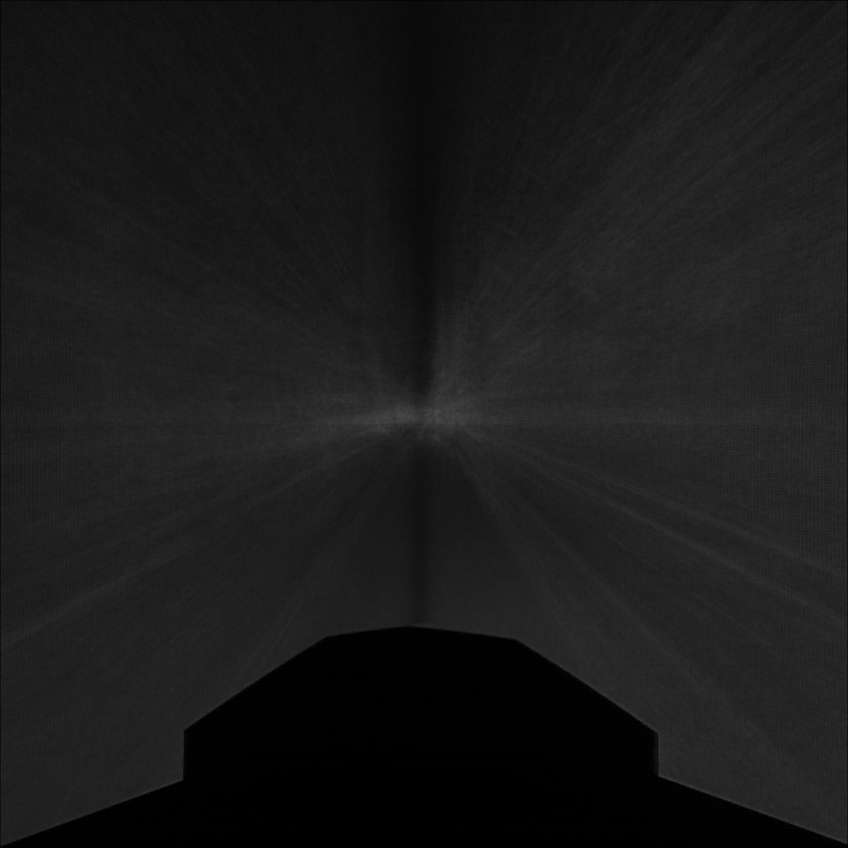
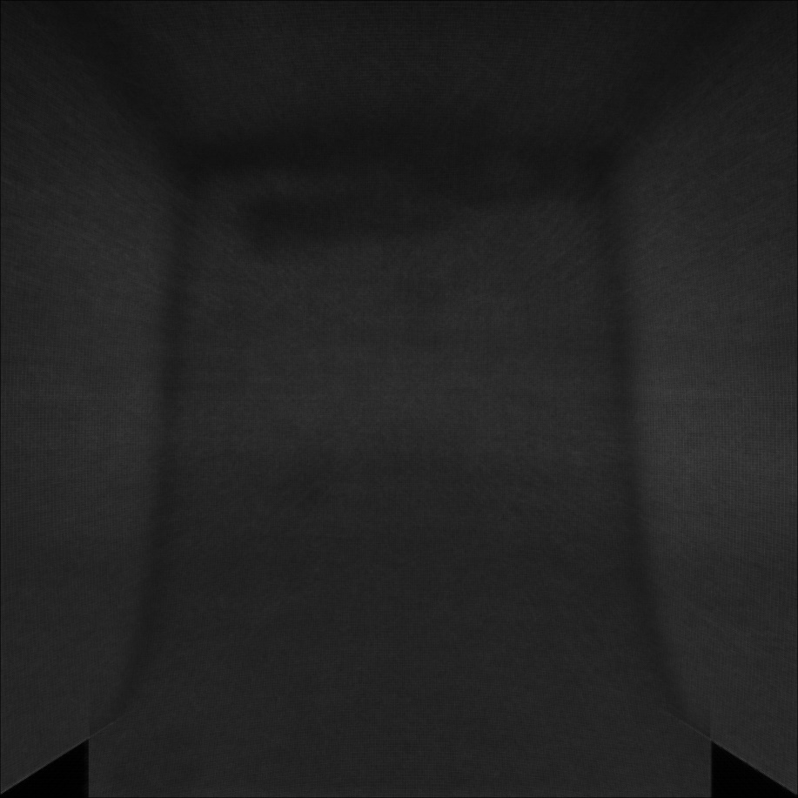
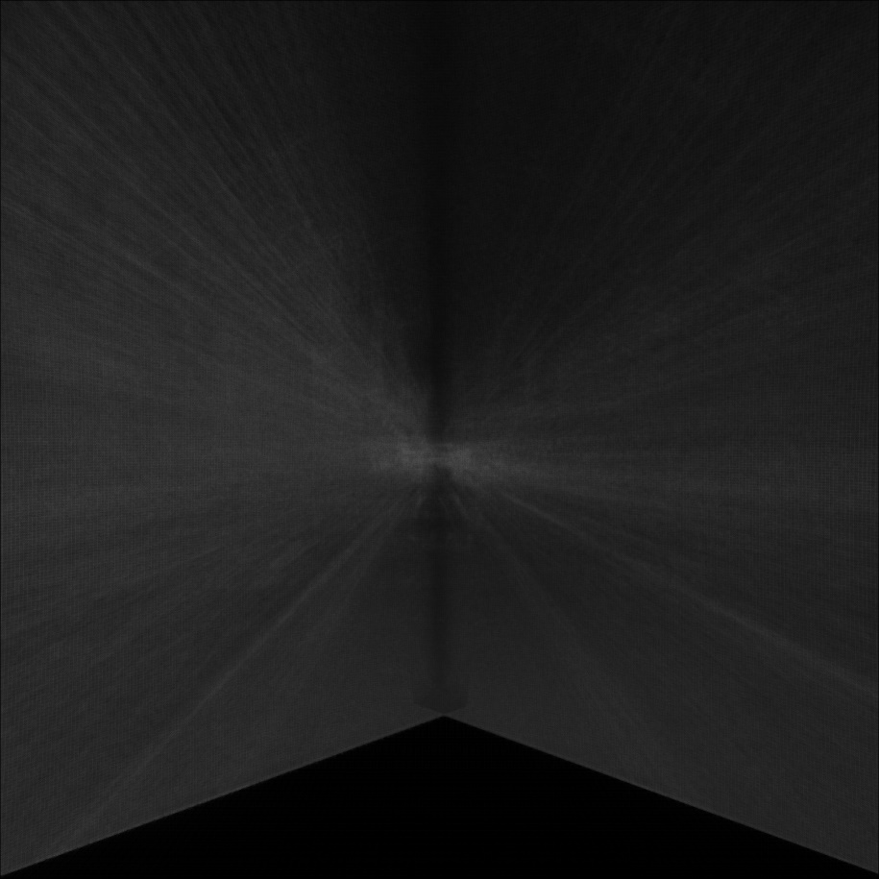
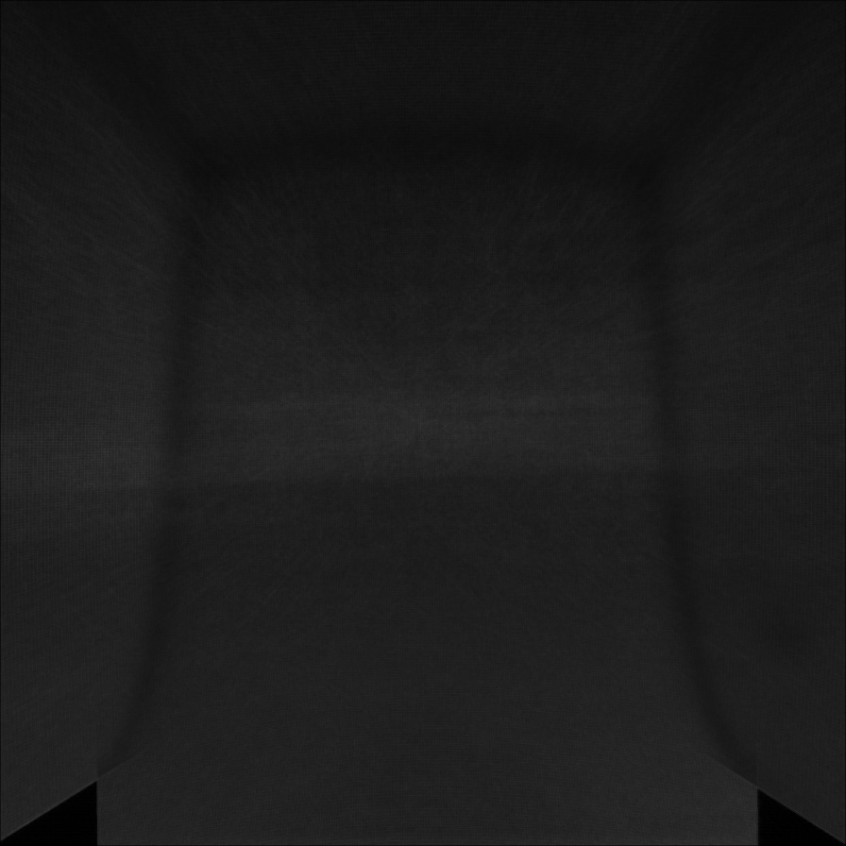
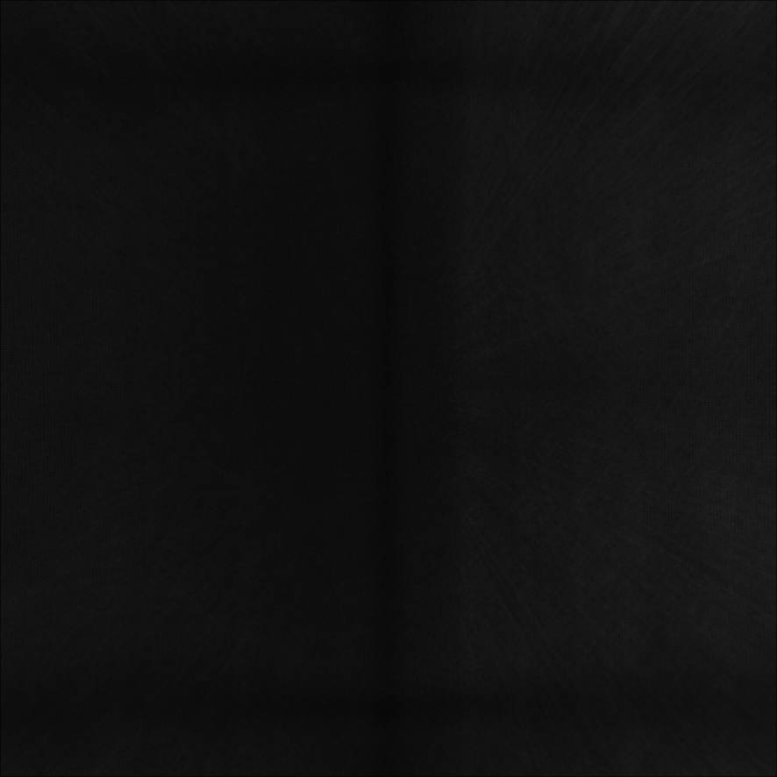
RESULT
Average GRAYSCALE image of 400 samples:
Com_0
Com_1
Com_2
Com_3
Com_5

Slide 12

RESULT(cont)
MASK image for sample com_0: (check the rest result in result folder)

Slide 13
DISCUSSION AND CONCLUSIONS
As a result of adding up images, all edges that are not present in every picture in the series of pictures will turn white. That means that edges that are constant from picture to picture will remain black.
The blur region on images due to smear on camera lens was then detected and was encircled in blue.
Detects smears that are visible on pictures.
Capable of detecting a smear that was acquired in the middle of the ride.
A lot of false-positives are generated if background doesn’t change.
Can’t detect thin and transparent smears.

Slide 14
REFERENCES
http://docs.opencv.org/trunk/da/d22/tutorial_py_canny.html
https://pythonprogramming.net/canny-edge-detection-gradients-python-opencv-tutorial/
http://docs.opencv.org/3.2.0/d4/d73/tutorial_py_contours_begin.html
http://miriamposner.com/classes/medimages/3-use-opencv-to-find-the-average-color-of-an-image/
5. "Removing Image Artifacts Due to Dirty Camera LensesandThinOccluders,"J.Gu,R.Ramamoorthi,P.N. Belhumeur and S.K.Nayar.
6. DigitalImageProcessing,byRafael C.Gonzalez.

